Slide 1






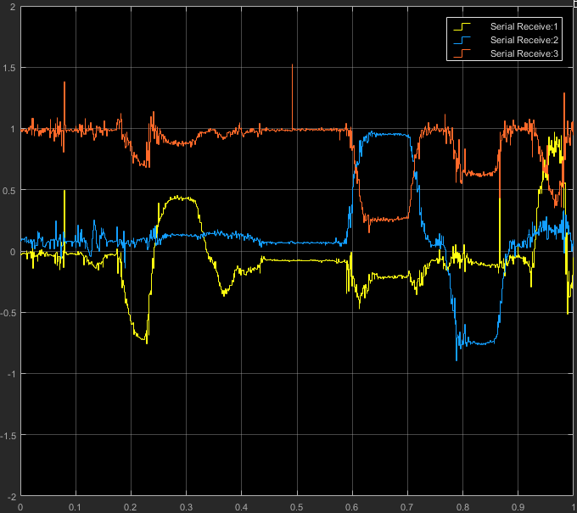
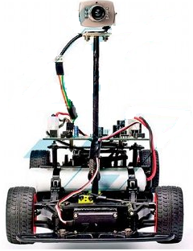

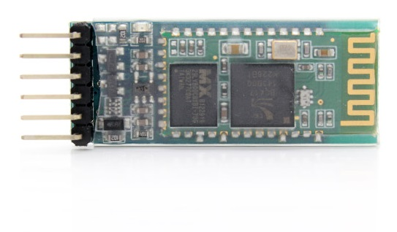
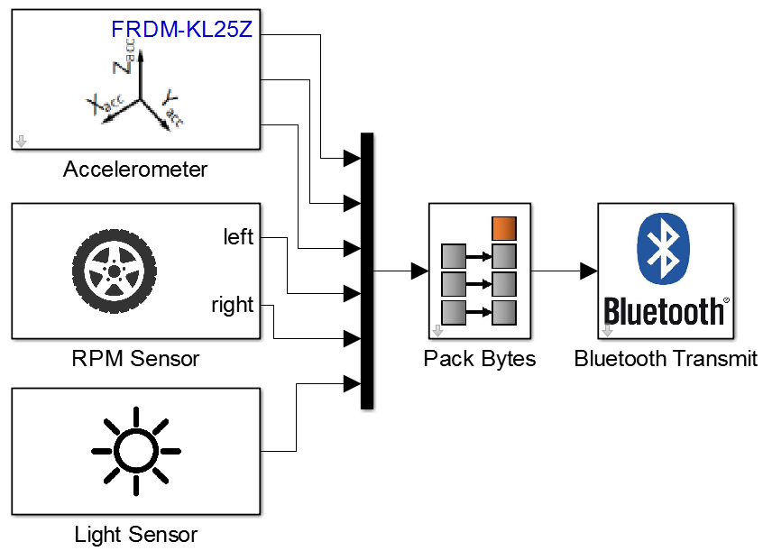
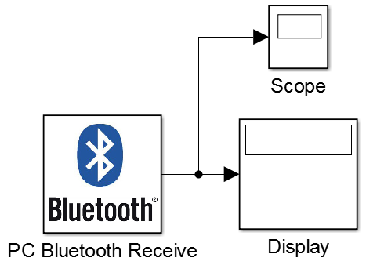
Simplified Telemetry Framework for the Freescale Cup
Daniel C. Castro, Matt Douthwaite, Sanket Kamthe
Introduction
The Freescale Cup is an autonomous racing car competition for high-school and undergraduate students. Cars are equipped with a Freescale Freedom Board, powered by MathWorks Simulink software. Competitors need to design and tune their car’s control algorithms to follow a track as fast as possible.
Currently, a few advanced teams develop their own data gathering solutions for testing, while the majority relies on trial and error.
We propose an accessible wireless framework to acquire real-time feedback from multiple sensors.
Bluetooth Communication
RPM Sensor
Our main objective was to establish a transparent communication link from the car to a PC.
We chose to use Bluetooth, as it is one of the most prevalent and power-efficient short-range wireless technologies available.
We identified a digital Hall Effect sensor² as a reliable method of counting wheel rotations in order to determine revolutions per minute (RPM). Using a Schmitt trigger, this sensor produces a clean digital output in the presence of a magnetic field.
Four 2x1 mm magnets³ were attached to each wheel, held in place by additional magnets on the inside of the tyre.
The HC-05 Bluetooth module¹ is very popular among hobbyists: cheap and works effortlessly off the shelf.
1 cm
3.3
0
Vout (V)
Bluetooth uses a standard 8-bit asynchronous serial communication protocol, so we convert the 64-bit real-valued sensor outputs into a 8x 8-bit byte stream.
RPM
Time
sync.
header
To synchronize the incoming data, we implemented a byte packet structure with a custom header. This is done so the values transmitted in a given time frame can be de-multiplexed in the proper order without ambiguity.
Time
real-valued
sensor
outputs
byte
stream
We developed a filtering algorithm to estimate the frequency of the incoming signal and then convert it to RPM.
In future developments, the header can be made to transmit packet meta-data, e.g. packet length and data types.
Ambient Light Sensor
Varying light conditions around the track can significantly interfere with the line scan camera. Measuring light intensity can allow the control algorithm to adapt to its environment.
???
We chose to use a small analogue photodiode⁴ to sense ambient lighting. Our sensor module provides tuneable gain for the sensor’s output.
Synchronized
Deliverables and Conclusions
Hardware guidelines: help users physically set up and connect the Bluetooth module and sensors on the car.
Bluetooth Simulink blocks: stream any number of data sources from the car in real time through a reliable wireless connection.
Sensors Simulink blocks: easily incorporate speed and luminance measurements into users’ control and testing routines.
During this project we have developed a simplified end-to-end telemetry framework, integrated into Simulink’s intuitive drag-and-drop block interface. We provide two additional types of sensor not originally available on the Freedom Board.
Finally, we hope Freescale Cup competitors will adopt our framework and that it will help them develop smarter, more reactive control for their cars.
Freedom Board (Car)
PC
An example Simulink model for the car and a simple receiving model for a listening PC, employing our whole hardware > C > MATLAB > Simulink stack
All our source code for this project can be found on the following GitHub repository: https://github.com/mattdouthwaite/HiPEDS-Sensors-Group
¹Bluetooth module: HC-05 (£4); ²Hall Effect sensor: A1120EUA-T (£1), ³Magnets: 50x 2x1mm N42 Neodymium magnets (£4.70), ⁴Photodiode: TEMD5510 (£3). [^{1,3}From Amazon.com; ^{2,4}From Hobbytronics.co.uk]

